Slide 1
CS 2212
Introduction to Software Engineering
Chapter 9 Design Concepts

Slide 2
Copyright Notice This Presentation and Its Associated Video Contain Copyright Material. This Presentation and Its Associated Video Are Provided for Teaching Purposes of CS2212 and Should Not Be Posted In Any External Site, Or Shared with. This Presentation and Its Associated Video Are Provided For Instructional Personal Use Only, and Only For The Purposes of the CS2212 Course.

Slide 3
Part 23
Foundational Software Design Principles
Without requirements and design, programming is the art of adding bugs to an empty text file.
― Louis Srygley
Notes:
This lesson introduces the basic steps in a software engineering project at a high level.
In practice, steps often overlap.

Slide 4
Learning Objectives in this Part
To understand the concepts of abstraction, modularization, separation of concerns, and information hiding (slides 4-14)

Slide 5
Design Concepts
Abstraction—removal or masking of detail and complexity
Architecture—the overall structure of the software
Patterns—“conveys the essence” of a proven design solution
Separation of concerns—any complex problem can be more easily handled if it is subdivided into pieces
Modularity—compartmentalization of data and function
Information hiding—controlled interfaces

Slide 6
Abstraction
“Abstraction is one of the fundamental ways that we as humans cope with complexity.”
- Grady Booch

Slide 7
Modularity
Modularity is the most common and simplest manifestation of separation of concerns.
When applying modularity, software is divided into separately named and addressable components, also referred to as modules, that are integrated to satisfy problem requirements.
“Modularity is the single attribute of software that allows a program to be intellectually manageable”

Slide 8
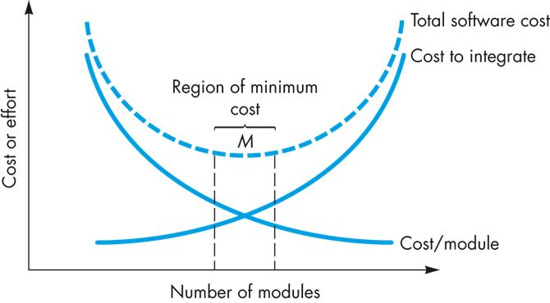
Modularity: Trade-offs
What is the right number of modules for a given system?

Slide 9
Why modularize a system?
Management: Partition the overall development effort
divide and conquer (actually: “Divide et impera” = “Divide and rule”)
Evolution: Decouple parts of a system so that changes to one part are isolated from changes to other parts
Principle of directness (clear allocation of requirements to modules, ideally one requirement (or more) maps to one module)
Principle of continuity (small change in requirements triggers a change to one module only)
Understanding: Permit system to be understood
as composition of mind-sized chunks
e.g., the 7±2 Rule
with one issue at a time
Principle of locality, encapsulation, separation of concerns
Key issue: what criteria to use for modularization

Slide 10
System Decomposition
Subsystem (UML: Package)
Collection of classes, associations, operations, events and constraints that are interrelated
Seed for subsystems: UML Objects and Classes.
(Subsystem) Service:
Group of operations provided by the subsystem
Seed for services: Subsystem use cases
Service is specified by Subsystem interface:
Specifies interaction and information flow from/to subsystem boundaries, but not inside the subsystem.
Should be well-defined and small.
Often called API: Application programmer’s interface, but this term should used during implementation, not during System Design
Notes:
Relation of subsystems to each other is similar to object model
System topology is similar functional model!

Slide 11
Separation of Concerns
Separation of concerns is a design concept that suggests that any complex problem can be more easily handled if it is subdivided into pieces that can each be solved and/or optimized independently
A concern is a feature or behavior that is specified as part of the requirements model for the software
By separating concerns into smaller, and therefore more manageable pieces, a problem takes less effort and time to solve using a divide-and-conquer strategy

Slide 12
Functional Independence
Functional independence is achieved by developing modules with “single-minded” purpose and an “aversion” to excessive interaction with other modules
Cohesion is an indication of the relative functional strength of a module
A cohesive module performs a single task, requiring little interaction with other components in other parts of a program; stated simply, a cohesive module should (ideally) do just one thing
Coupling is an indication of the relative interdependence among modules
Coupling depends on the interface complexity between modules, the point at which entry or reference is made to a module, and what data pass across the interface

Slide 13
Information hiding (Parnas)
Hide secrets. OK, what’s a “secret”?
Representation of data
Properties of a device, other than required properties
Implementation of world models
Mechanisms that support policies
Try to localize future change
Hide system details likely to change independently
Separate parts that are likely to have a different rate of change
Expose in interfaces assumptions unlikely to change

Slide 14
Further Principles
Explicit interfaces
make all dependencies between modules explicit (no hidden coupling)
Low coupling - few interfaces
minimize the amount of dependencies between modules
Small interfaces
keep the interfaces narrow
combine many parameters into structs/objects
divide large interfaces into several interfaces
High cohesion
a module should encapsulate some well-defined, coherent piece of functionality (more on that later)

Slide 15
Cohesion and Coupling
Cohesion is a property of one component or a class
Denotes “The measure of the strength of functional relatedness of elements within a module”
High cohesion: The classes in a component (or the methods in a class) offer related to each other functionality. They are also related, using associations
Low cohesion: The classes in a component (or the methods in a class) offer functionality that are not related between them. Also these classes are not related using associations
Coupling is a measure of dependency between two or more subsystems
Denotes “The degree of interdependence between software modules; a measure of how closely connected two routines or modules are”
High coupling: Changes in one subsystem or component cause changes or affect the function of the other subsystems
Low coupling: Changes in one subsystem or component cause changes or affect the function of the other subsystems
A system has to exhibit high cohesion with respect to each of its components and low coupling between its associated components

Slide 16
Part 24
Cohesion
Without requirements and design, programming is the art of adding bugs to an empty text file.
― Louis Srygley
Notes:
This lesson introduces the basic steps in a software engineering project at a high level.
In practice, steps often overlap.

Slide 17
Learning Objectives in this Part
To understand the concept and levels of cohesion

Slide 18
Cohesion Types
1. Coincidental Cohesion
2. Logical cohesion
3. Temporal cohesion
4. Procedural cohesion
5. Communicational cohesion
6. Sequential cohesion
7. Functional cohesion
8. Informational cohesion
Low Cohesion - Bad
High Cohesion - Good

Slide 19
Cohesion at a Glance
Co-incidental cohesion - It is unplanned and random cohesion, which might be the result of breaking the program into smaller modules for the sake of modularization. Because it is unplanned, it may serve confusion to the programmers and is generally not-accepted.
Logical cohesion - When logically categorized elements are put together into a module, it is called logical cohesion.
Temporal Cohesion - When elements of module are organized such that they are processed at a similar point in time, it is called temporal cohesion.
Procedural cohesion - When elements of module are grouped together, which are executed sequentially in order to perform a task, it is called procedural cohesion.
Communicational cohesion - When elements of module are grouped together, which are executed sequentially and work on same data (information), it is called communicational cohesion.
Sequential cohesion - When elements of module are grouped because the output of one element serves as input to another and so on, it is called sequential cohesion.
Functional cohesion - It is considered to be the highest degree of cohesion, and it is highly expected. Elements of module in functional cohesion are grouped because they all contribute to a single well-defined function.
https://www.tutorialspoint.com/software_engineering/software_design_basics.htm

Slide 20
Coincidental cohesion
The result of randomly breaking the project into modules to gain the benefits of having multiple smaller files/modules to work on
Inflexible enforcement of rules such as: “every function/module shall be between 40 and 80 lines in length” can result in coincidental coherence
Usually worse than no modularization
Confuses the reader that may infer dependencies that are not there

Slide 21
Coincidental cohesion
Elements contribute to activities with no meaningful relationship to one another
Similar to logical cohesion, except the activities may not even be the same type
Difficult to understand and maintain, with strong possibilities of causing ‘side effects’ every time the module is modified
Example of Coincidental Cohesion
module miscellaneous functions
use customer record
display customer record
calculate total sales
read transaction record
return transaction record
end module
https://www.avatto.com/study-material/software-engineering-cohesion

Slide 22
Logical cohesion
A “template” implementation of a number of quite different operations that share some basic course of action
variation is achieved through parameters
“logic” - here: the internal workings of a module
Problems:
Results in hard to understand modules with complicated logic
Undesirable coupling between operations
Usually should be refactored to separate the different operations

Slide 23
Examples of Logical Cohesion
void function(param1, param2, param3, ..., paramN)
{
variable declarations....
code common to all cases... [A]
if ( param1 == 1 ) [B]
...
else if ( param1 == 2 )
...
else if ( param1 == n )
...
end if
code common to all cases... [C]
if ( param == 1) [D]
...
else if ( param1 == 5 )
...
end if
code common to all cases... [E]
if ( param1 == 7 )
...
}
module display record
use record-type, record
if record-type is student then
display student record
else if record-type is staff then
display staff record
end module
https://www.avatto.com/study-material/software-engineering-cohesion

Slide 24
Temporal Cohesion
Temporal cohesion concerns a module organized to contain all those operations which occur at a similar point in time.
Consider a product performing the following major steps:
initialization, get user input, run calculations, perform appropriate output, cleanup.
Temporal cohesion would lead to five modules named initialize, input, calculate, output and cleanup.
This division will most probably lead to code duplication across the modules, e.g.,
Each module may have code that manipulates one of the major data structures used in the program.
Commonly found in initialisation and termination modules

Slide 25
Example of Temporal Cohesion
module initialise
set counter to 0
open student file
clear error message variable
initialise array
end module
https://www.avatto.com/study-material/software-engineering-cohesion

Slide 26
Procedural Cohesion
A module has procedural cohesion if all the operations it performs are related to a sequence of steps performed in the program.
For example, if one of the sequence of operations in the program was “read input from the keyboard, validate it, and store the answers in global variables”, that would be procedural cohesion.
Procedural cohesion is essentially temporal cohesion with the added restriction that all the parts of the module correspond to a related action sequence in the program.
It also leads to code duplication in a similar way.

Slide 27
Example of Procedural Cohesion
Module A
Module B
operationA()
{ readData(data,filename1);
processAData(data);
storeData(data,filename2);
}
operationB()
{ readData(data,filename1);
processBData(data);
storeData(data,filename2);
}
readData(data,filename)
{ f := openfile(filename);
readrecords(f, data);
closefile(f);
}
storeData(data,filename)
{...}
processAData(data)
{...}
readData(data,filename)
{ f := openfile(filename);
readrecords(f, data);
closefile(f);
}
storeData(data,filename)
{...}
processBData(data)
{...}

Slide 28
Example of Procedural Cohesion
module write read and edit something
use out record
write out record
read in record
pad numeric fields with zeros
return in record
end module
https://www.avatto.com/study-material/software-engineering-cohesion

Slide 29
Communicational Cohesion
Communicational cohesion occurs when a module performs operations related to a sequence of steps performed in the program (see procedural cohesion) AND all the actions performed by the module are performed on the same data.
Communicational cohesion is an improvement on procedural cohesion because all the operations are performed on the same data.

Slide 30
Example of Communicational Cohesion
module determine customer details
use customer account no
find customer name
find customer loan balance
return customer name, loan balance
end module
https://www.avatto.com/study-material/software-engineering-cohesion

Slide 31
Sequential Cohesion
Elements are involved in activities such that output data from one activity becomes input data to the next
Usually has good coupling and is easily maintained
Not so readily reusable because activities that will not in general be useful together
https://www.avatto.com/study-material/software-engineering-cohesion

Slide 32
Example of Sequential Cohesion
module format and cross-validate record
use raw record
format raw record
cross-validate fields in raw record
return formatted cross-validated record
end module
https://www.avatto.com/study-material/software-engineering-cohesion

Slide 33
Functional Cohesion
Module with functional cohesion focuses on exactly one goal or “function”
(in the sense of purpose, not a programming language “function”).
Module performing a well-defined operation is more reusable, e.g.,
modules such as: read_file, or draw_graph are more likely to be applicable to another project than one called initialize_data.
Another advantage of is fault isolation, e.g.,
If the data is not being read from the file correctly, there is a good chance the error lies in the read_file module/function.​
Examples of functional cohesive modules:
Compute cosine of angle
Read transaction record
Assign seat to airline passenger
https://www.avatto.com/study-material/software-engineering-cohesion

Slide 34
Informational Cohesion
Informational cohesion describes a module as performing a number of actions, each with a unique entry point, independent code for each action, and all operations are performed on the same data.
In informational cohesion, each function in a module can perform exactly one action.
It corresponds to the definition of an ADT (abstract data type) or object in an object-oriented language.
Thus, the object-oriented approach naturally produces designs with informational cohesion.
Each object is generally defined in its own source file/module, and all the data definitions and member functions of that object are defined inside that source file (or perhaps one other source file, in the case of a .hpp/.cpp combination).

Slide 35
Examples of Cohesion
Function A
Function A
Function A’
Function A’’
Time t₀
Time t₀ + X
Time t₀ + 2X
Function
B
Function
C
logic
Function
D
Function
E
Coincidental
Parts unrelated
Logical
Similar functions
Temporal
Related by time
Function A
Function B
Function C
Procedural
Related by order of functions
35

Slide 36
Examples of Cohesion (Cont.)
Function A
Function B
Function C
Function A
Function B
Function C
Communicational
Access same data
Sequential
Output of one is input to another
Function A part 1
Function A part 2
Function A part 3
Functional
Sequential with complete, related functions
36

Slide 37
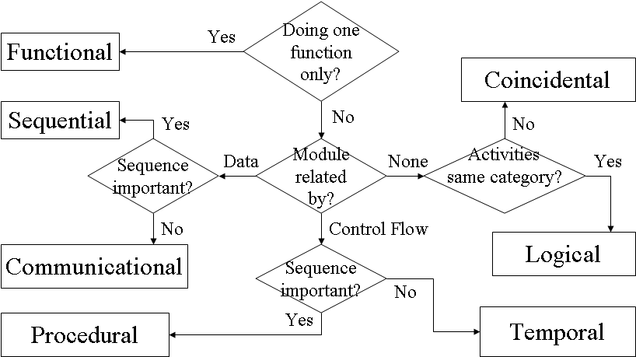
Determining Module Cohesion
https://www.avatto.com/study-material/software-engineering-cohesion

Slide 38
Part 25
Coupling
The code you write makes you a programmer. The code you delete makes you a good one. The code you don't have to write makes you a great one.
― Mario Fuscot
Notes:
This lesson introduces the basic steps in a software engineering project at a high level.
In practice, steps often overlap.

Slide 39
Learning Objectives in this Part
To understand the concept and levels of coupling (slides 36-45)

Slide 40
Levels of Coupling
5. Content Coupling (High Coupling - Bad)
4. Common Coupling
3. Control Coupling
2. Stamp Coupling
1. Data Coupling (Low Coupling - Good)

Slide 41
Coupling at a Glance
Content coupling - When a module can directly access or modify or refer to the content of another module, it is called content level coupling.
Common coupling- When multiple modules have read and write access to some global data, it is called common or global coupling.
Control coupling- Two modules are called control-coupled if one of them decides the function of the other module or changes its flow of execution.
Stamp coupling- When multiple modules share common data structure and work on different part of it, it is called stamp coupling.
Data coupling- Data coupling is when two modules interact with each other by means of passing data (as parameter). If a module passes data structure as parameter, then the receiving module should use all its components.
https://www.tutorialspoint.com/software_engineering/software_design_basics.htm

Slide 42
Content Coupling
One module directly refers to the content of the other
module 1 modifies a statement of module 2
assembly languages typically supported this, but not high-level languages
COBOL, at one time, had a verb called alter which could also create self-modifying code (it could directly change an instruction of some module).
module 1 refers to local data of module 2 in terms of some kind of offset into the start of module 2.
This is not a case of knowing the offset of an array entry - this is a direct offset from the start of module 2's data or code section.
module 1 branches to a local label contained in module 2.
This is not the same as calling a function inside module 2 - this is a goto to a label contained somewhere inside module 2.

Slide 43
Common Coupling
Common coupling exists when two or more modules have read and write access to the same global data.
Common coupling is problematic in several areas of design/maintenance.
Code becomes hard to understand - need to know all places in all modules where a global variable gets modified
Hampered reusability because of hidden dependencies through global variables
Possible security breaches (an unauthorized access to a global variable with sensitive information)
It’s ok if just one module is writing the global data and all other modules have read-only access to it.

Slide 44
Common Coupling
Consider the following code fragment:
while( global_variable > 0 )
{ switch( global_variable )
{ case 1: function_a(); break;
case 2: function_b(); break;
...
case n: ...
}
global_variable++;
}

Slide 45
Common Coupling
If function_a(), function_b(), etc can modify the value of global variable, then it can be extremely difficult to track the execution of this loop.
If they are located in two or more different modules, it becomes even more difficult
potentially all modules of the program have to be searched for references to global variable, if a change or correction is to take place.
Another scenario is if all modules in a program have access to a common database in both read and write mode, even if write mode is not required in all cases.
Sometimes necessary, if a lot of data has to be supplied to each module

Slide 46
Control Coupling
Two modules are control-coupled if module 1 can directly affect the execution of module 2, e.g.,
module 1 passes a “control parameter” to module 2 with logical cohesion, or
the return code from a module 2 indicates NOT ONLY success or failure, but also implies some action to be taken on the part of the calling module 1 (such as writing an error message in the case of failure).
The biggest problem is in the area of code re-use: the two modules are not independent if they are control coupled.

Slide 47
Stamp Coupling
It is a case of passing more than the required data values into a module, e.g.,
passing an entire employee record into a function that prints a mailing label for that employee. (The data fields required to print the mailing label are name and address. There is no need for the salary, SIN number, etc.)
Making the module depend on the names of data fields in the employee record hinders portability.
If instead, the four or five values needed are passed in as parameters, this module can probably become quite reusable for other projects.
As with common coupling, leaving too much information exposed can be dangerous.

Slide 48
Data Coupling
Data coupling exhibits the properties that all parameters to a module are either simple data types, or in the case of a record being passed as a parameter, all data members of that record are used/required by the module. That is, no extra information is passed to a module at any time.

Slide 49
Your Turn
What is abstraction? Give two examples in the context of Software Engineering?
Why modularization is an important property of a good design?
Why cohesion and coupling are important? What purposes do they serve? Explain.
Research how one can measure software cohesion and software coupling at the component or at the class level.
Check-out the content of the following sites:
https://en.wikipedia.org/wiki/Cohesion_(computer_science)
https://stackoverflow.com/questions/3085285/cohesion-coupling
https://www.coursera.org/learn/software-processes/lecture/LWhWM/software-design-cohesion
https://en.wikipedia.org/wiki/Coupling_(computer_programming)
https://www.coursera.org/learn/software-processes/lecture/BNSI0/software-design-coupling
https://www.avatto.com/study-material/software-engineering-cohesion

